Slide 1
Classical Encryption Techniques
Prof. M. Odeo

Slide 2
Basic Encryption and decryption
Suppose S wants to send a message to R; we call S the sender and R the receiver.
S entrusts the message to T, who will deliver it to R; T then becomes the transmission medium.
If an outsider, O, wants the message and tries to access it, we will call O an intercepter or intruder.
Any time after S transmits the messege via T, the message is exposed, so O might try to access it in any of the following ways:

Slide 3
Basic Encryption and decryption
Bock it, - by preventing its reading by R, thereby affecting the availability
Intercept it, - by reading and listening to the message, thereby affecting the secrecy of message.
Modify it, - by seizing the message and changing it in some way or adding to it, affecting the message’s integrity.
Fabricate an authentic –looking message, arranging it to be delivered as if it came from S, thereby affecting the integrity of the message.

Slide 4
Basic Encryption and decryption
NB:
Encryption is the technique that can address all of these problems.

Slide 5
Basic Encryption and decryption
Encryption is the process of encoding a message so that its meaning is not obvious.
Decryption is the reverse process: transforming an encrypted message back into its normal form.
Alternatevely, the terms encode and decode or encipher and decipher are used instead of verbs encrypt and decrypt.
A system for encryption and decryption is called Cryptosystem.

Slide 6
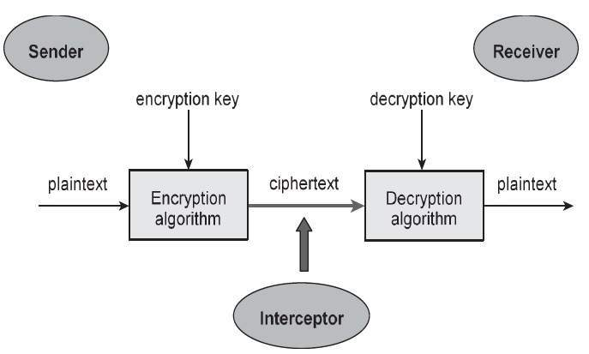
Basic Encryption and decryption
The original form of a message is known as plaintext, and the encrypted form is called ciphertext.
For convenience in explanations, we may denote a plaintext message P as a sequence of individual character
p = (p1,p2,p3, … , pn)

Slide 7
Basic Encryption and decryption
Similarly ciphertext can be written as
C = (c1,c2,c3,…,cm).
Formally, the transformations between plaintext and ciphertext are denoted.
C = E(P) and P = D(C),
Where
C represents ciphertext, E is the encryption algorithm, P is the plain text, and D is the decryption algorithm.
We want a cryptosystem for which P = D(E(P)).

Slide 8
Encryption Algorithms
Some encryption algorithms use a key k, so that the ciphertext message depends on both the original plaintext message and the key value, denoted;
c = E(k,p).
Where k is a set of encyption algorithms, and the key k selects one specific algorithm.
Sometimes the encryption and decryption keys are the same, so that p = D(k,E(k,p)
This style of encryption is called symmetric encryption because D and E are mirror –image processes.
<Draw>

Slide 9
Encryption Algorithms
At other times encryption and decryption key come in pairs.
Then a decryption key, KD inverts the ecryption of ker KE, so that
        P =D(KD, E(KE, p)
Encryption algorithms of this form are called asymmetric, because converting C back to P is not just reversing the steps of E

Slide 10
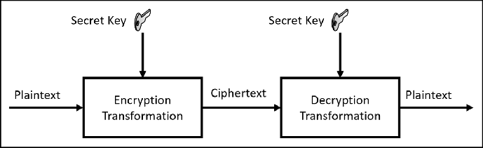
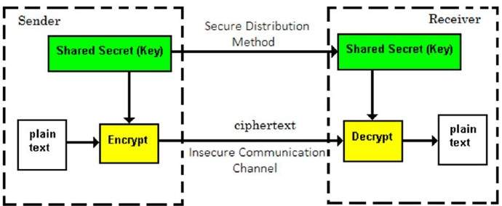
(a) Symmetric cryptosystem

Slide 11
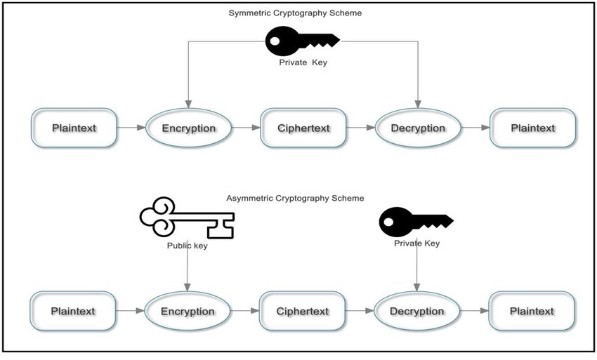
(b) Symmetric vs Asymmetric Encryption

Slide 12
Basic Vocabulary of Classical
Encryption
Plaintext: This is what you want to encrypt
Ciphertext: The encrypted output
Enciphering or encryption: The process by which plaintext is converted into ciphertext

Slide 13
Basic Vocabulary of Classical
Encryption
Encryption algorithm: The sequence of data processing steps that go into transforming plaintext into ciphertext.
Various parameters used by an encryption algorithm are derived from a secret key.
In classical cryptography for commercial and other civilian applications, the encryption algorithm is made public.

Slide 14
Basic Vocabulary of Classical
Encryption
Secret key: A secret key is used to set some or all of the various parameters used by the encryption algorithm.
The important thing to note is that the same secret key is used for encryption and decryption in classical cryptography.
It is for this reason that classical cryptography is also referred to as symmetric key cryptography.

Slide 15
Basic Vocabulary of Classical
Encryption
Deciphering or decryption: Recovering plaintext from cipher-text
Decryption algorithm: The sequence of data processing steps that go into transforming ciphertext back into plaintext.
Various parameters used by a decryption algorithm are derived from the same secret key that was used in the encryption algorithm.
In classical cryptography for commercial and other civilian applications, the decryption algorithm is made public.

Slide 16
Basic Vocabulary of Classical
Encryption
Cryptography: The many schemes available today for encryption and decryption
Cryptographic system: Any single scheme for encryption
Cipher: A cipher means the same thing as a “cryptographic system”
Block cipher: A block cipher processes a block of input data at a time and produces an ciphertext block of the same size.

Slide 17
Basic Vocabulary of Classical
Encryption
Stream cipher: A stream cipher encrypts data on the fly, usually one byte at a time.
Cryptanalysis: Means “breaking the code”.
Cryptanalysis relies on a knowledge of the encryption algorithm (that for civilian
applications should be in the public domain) and some knowledge of the possible structure of the plaintext (such as the structure of a typical inter-bank financial transaction) for a partial or full reconstruction of the plaintext from ciphertext.

Slide 18
Basic Vocabulary of Classical
Encryption
Additionally, the goal is to also infer the key for decryption of future messages.
The precise methods used for cryptanalysis depend on whether the “attacker” has just a piece of ciphertext, or pairs of plaintext and ciphertext, how much structure is possessed by the plaintext, and how much of that structure is known to the attacker.
All forms of cryptanalysis for classical encryption exploit the fact that some aspect of the structure of plaintext may survive in the ciphertext.

Slide 19
Basic Vocabulary of Classical
Encryption
Brute-force attack:
When encryption and decryption algorithms are publicly available, a brute-force attack means trying every possible key on a piece of ciphertext until an intelligible translation into plaintext is obtained.

Slide 20
Basic Vocabulary of Classical
Encryption
Key space: The total number of all possible keys that can be used in a cryptographic system. For example, DES uses a 56-bit key. So the key space is of size 256, which is approximately the same as 7.2 × 1016.
Cryptology: Cryptography and cryptanalysis together constitute the area of cryptology

Slide 21
Building Blocks of Classical Encryption Techniques
Two building blocks of all classical encryption techniques are
  Substitution and
  Transposition.

Slide 22
Building Blocks of Classical Encryption Techniques
Substitution means replacing an element of the plaintext with an element of ciphertext.
Transposition means rearranging the order of appearance of the elements of the plaintext.
Transposition is also referred to as permutation.

Slide 23
Caesar Cipher
This is the earliest known example of a substitution cipher.
Each character of a message is replaced by a character three position down in the alphabet.
E.g.
  plaintext: are you ready
  ciphertext: DUH BRX UHDGB

Slide 24
Caesar Cipher
If we represent each letter of the alphabet by an integer that corresponds to its position in the alphabet, the formula for replacing each character ’p’ of the plaintext with a character ’C’ of the ciphertext can be expressed as
C = E( 3, p) = (p + 3) mod 26

Slide 25
Caesar Cipher
A more general version of this cipher that allows for any degree of shift would be expressed by
C = E( k, p ) = (p + k) mod 26

Slide 26
Caesar Cipher
The formula for decryption would be
p = D( k, C ) = (C - k) mod 26
In these formulas, ’k’ would be the secret key.
The symbols ’E’ and ’D’ represent encryption and decryption.

Slide 27
Monoalphabetic Ciphers
In a monoalphabetic cipher, our substitution characters are a random permutation of the 26 letters of the alphabet:
  plaintext letters: a b c d e f .....
  substitution letters: t h i j a b .....

Slide 28
Monoalphabetic Ciphers
The key now is the sequence of substitution letters.
In other words, the key in this case is the actual random permutation of the alphabet used.
Note that there are 26! permutations of the alphabet. That is a number larger than 4 × 1026.

Slide 29
Advantage and disadvantages of substitution Ciphers
Adv
  Simplicity; the pattern pi+n is easy to memorise
Disadv
  Very easy for an interceptor to predict the entire pattern of the encryption.

Slide 30
Polyalphabetic Ciphers: The Vigenere Cipher
In a monoalphabetic cipher, the same substitution rule is used for every substitution.
In a polyalphabetic cipher, the substitution rule changes continuously from letter to letter according to the elements of the encryption key.

Slide 31
Polyalphabetic Ciphers: The Vigenere Cipher
Let each letter of the encryption key denote a shifted Caesar cipher, the shift corresponding to the key.
This is shown on the next page.
Now a plaintext message may be encrypted as follows
  key: abracadabraabracadabraabracadabraab
  plaintext: canyoumeetmeatmidnightihavethegoods
  ciphertext:CBEYQUPEFKMEBK.....................

Slide 32
Polyalphabetic Ciphers: The Vigenere Cipher
The Vigenere cipher is an example of a polyalphabetic cipher.
Since, in general, the encryption key will be shorter than the message to be encrypted, for the Vigenere cipher the key is repeated, as illustrated in the above example where the key is the string “abracadabra”.

Slide 33
Transposition Techniques
All of our discussion so far has dealt with substitution ciphers. We have talked about monoalphabetic substitutions, polyalphabetic
substitutions, etc.
We will now talk about a different notion in classical cryptography: permuting the plaintext.

Slide 34
Transposition Techniques
This is how a pure permutation cipher could work: You write your plaintext message along the rows of a matrix of some size.
You generate ciphertext by reading along the columns. The order in which you read the columns is determined by the encryption key:

Slide 35
Transposition Techniques
key: 2 5 3 1 6 4
plaintext: m e e t m e
a t m i d n
i g h t f o
r t h e g o
d i e s x y
ciphertext: ETGTIMDFGXEMHHEMAIRDENOOYTITES
The cipher can be made more secure by performing multiple rounds of such permutations.

Slide 36
Public key cryptosystems
Private key Ciphers:
secret key cryptography, also known as symmetric cryptography, uses a single secret key for both encryption and decryption.
To use symmetric cryptography for communication, both the sender & receiver would have to know the key beforehand, or it would have to be sent along with the message.
The key would be physically handed to the receiver of the document who would then take it away with them.

Slide 37
Private key cipher
The secure transmission of the key is impossible over a computer network, so other methods were developed which could be used over comm. Networks
Problems with private key cipher
  Key sharing; what if the two have never met?
  Alice needs to keep 100 (many) different keys if she wishes to comm. With 100 different people.

Slide 38
Public-key cryptography
Public-key cryptography, also known as asymmetric cryptography, is a form of cryptography in which the key used to encrypt a message differs from the key used to decrypt it.
In public key cryptography, a user has a pair of cryptographic keys—a public key and a private key.
The private key is kept secret, while the public key may be widely distributed.

Slide 39
Public-key cryptography
Incoming messages would have been encrypted with the recipient's public key and can only be decrypted with his corresponding private key.
The keys are related mathematically, but the private key cannot be practically derived from the public key.

Slide 40
Branches of public key cryptography
The two main branches are:
Public key encryption — a message encrypted with a recipient's public key cannot be decrypted by anyone except the recipient possessing the corresponding private key. This is used to ensure confidentiality.
Digital signatures — a message signed with a sender's private key can be verified by anyone who has access to the sender's public key, thereby proving that the sender signed it and that the message has not been tampered with. This is used to ensure authenticity.

Slide 41
Analogy
public-key encryption is - like a locked mailbox with a mail slot.
  The mail slot is exposed and accessible to the public; anyone can drop a written message however, only the person who possesses the key can open the mailbox and read the message.
digital signatures is like - the sealing of an envelope with a personal wax seal.
  The message can be opened by anyone, but the presence of the seal authenticates the sender.

Slide 42
Problem of public-key
Is confidence - (ideally proof) that a public key is correct, belongs to the person or entity claimed (i.e., is 'authentic').
The usual approach to this problem are:
  to use a public-key infrastructure (PKI), in which one or more third parties, known as certificate authorities, certify ownership of key pairs. Another approach,
  used by PGP, is the "web of trust" method to ensure authenticity of key pairs.

Slide 43
Differences – public key cryptosystems vs private key cipher
The public encryption key is different from the secret encryption key
Infeasible for an attacker to find out the secret decryption key from the public encryption
No need to distribute a shared key before hand

Slide 44
End

